Slide 1



Ollama Installation
https://www.visionet.com

Slide 2
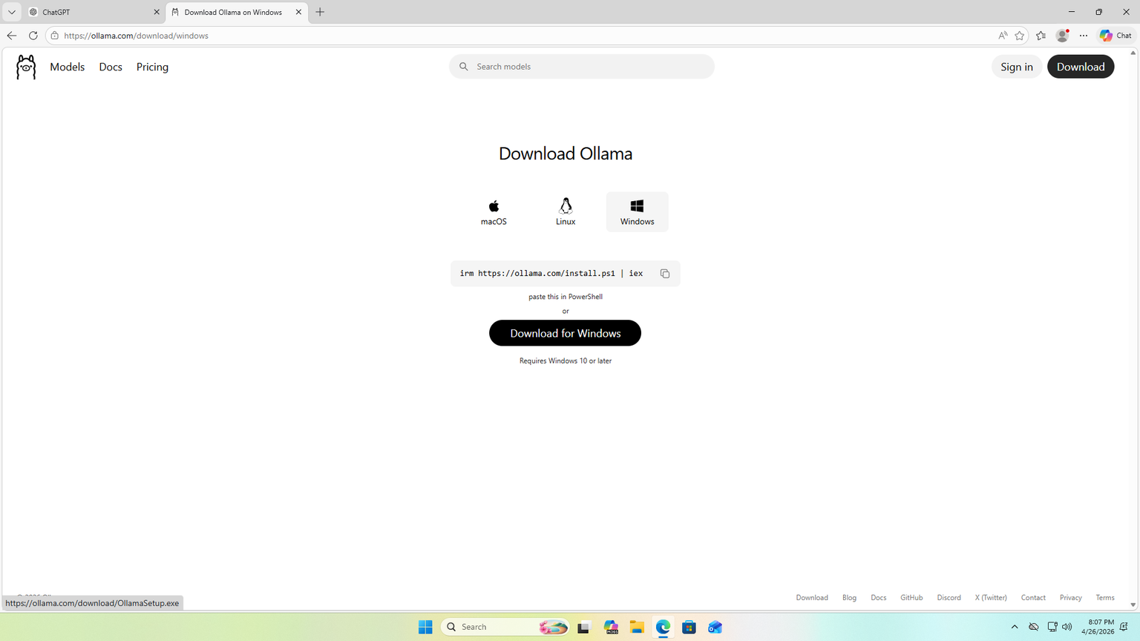
Step # 1
Visit:
https://ollama.com/download
Click Download for your preferred OS type.

Slide 3
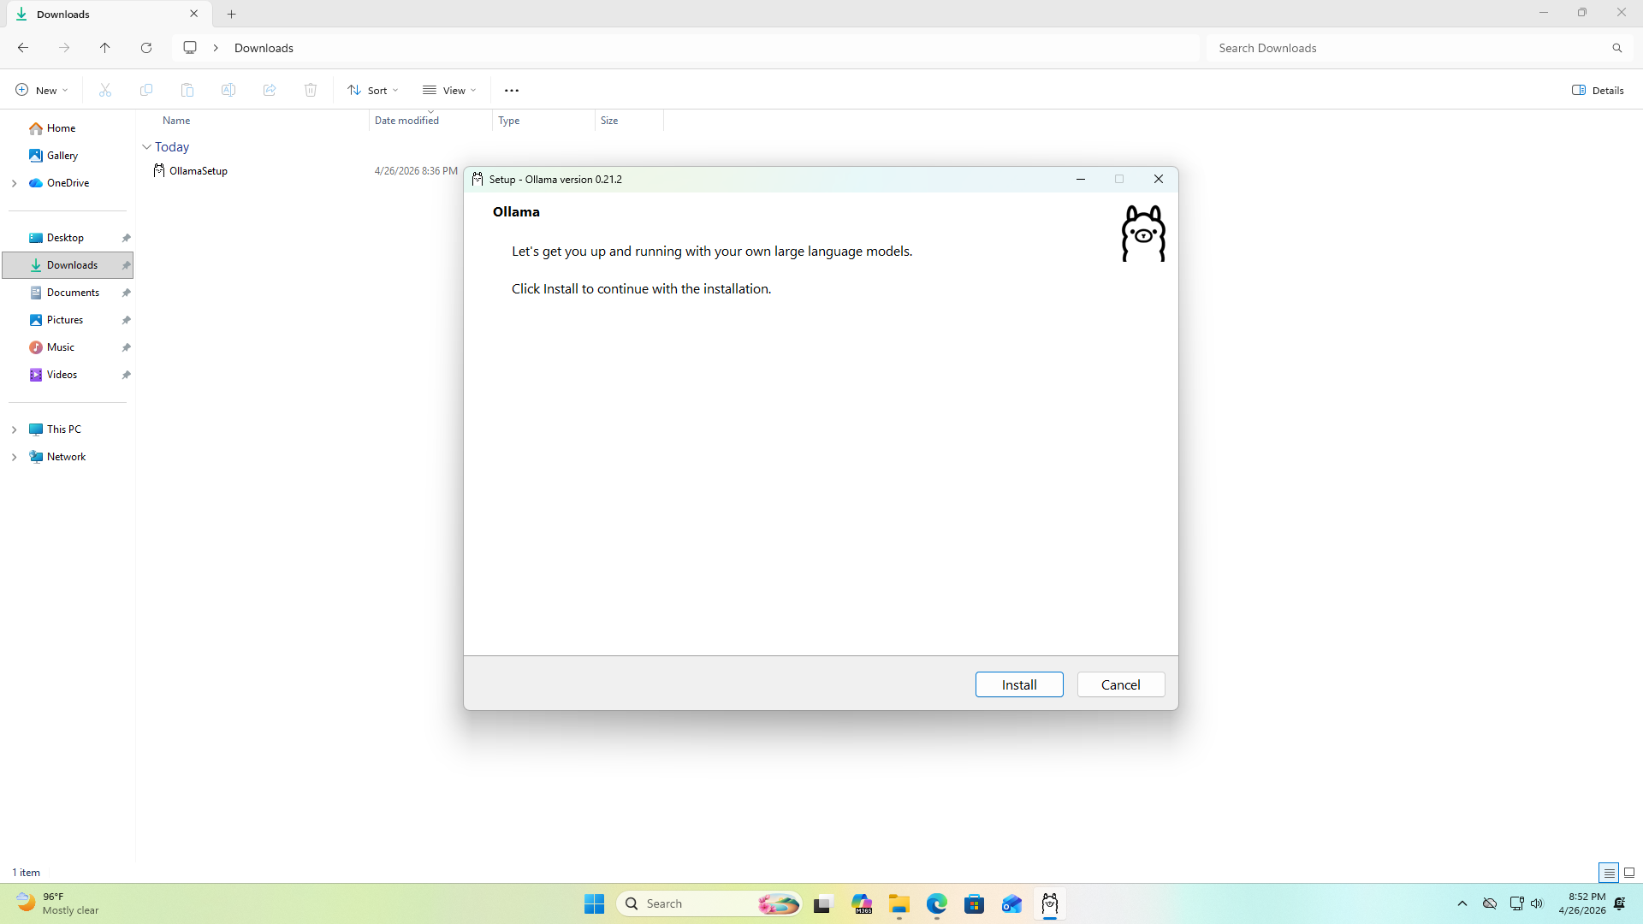


Step # 2
Open the installer.
Press Install and the installization will begin.

Slide 4
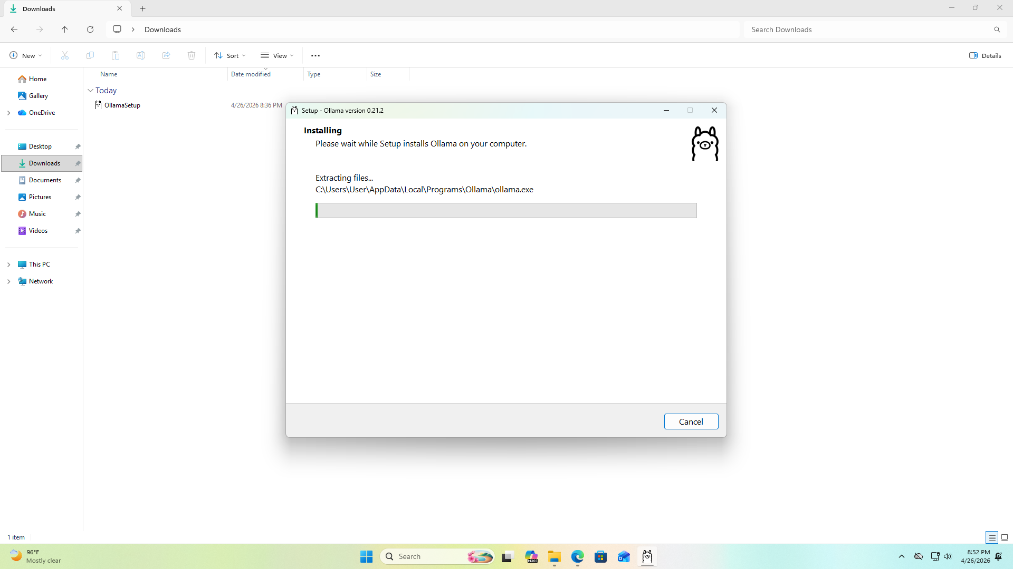
Step # 3
Wait for it get installed.

Slide 5
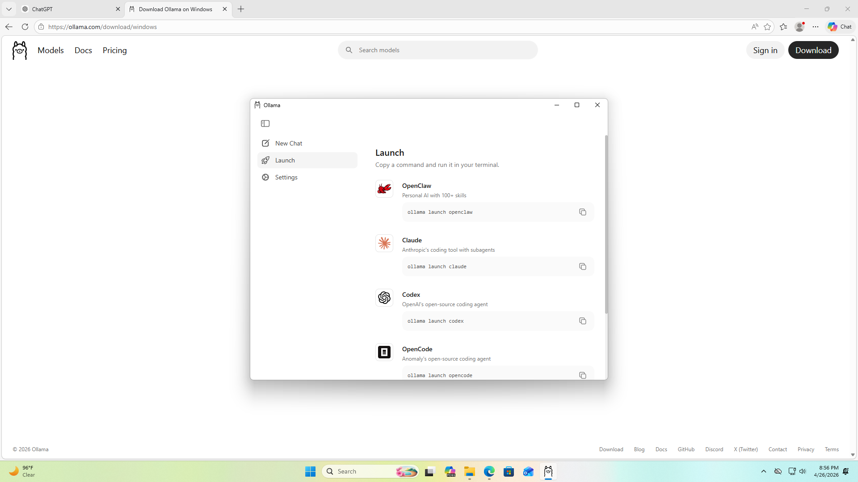
Step # 4
After successful installation this will appear.
It will display all the model’s available.

Slide 6
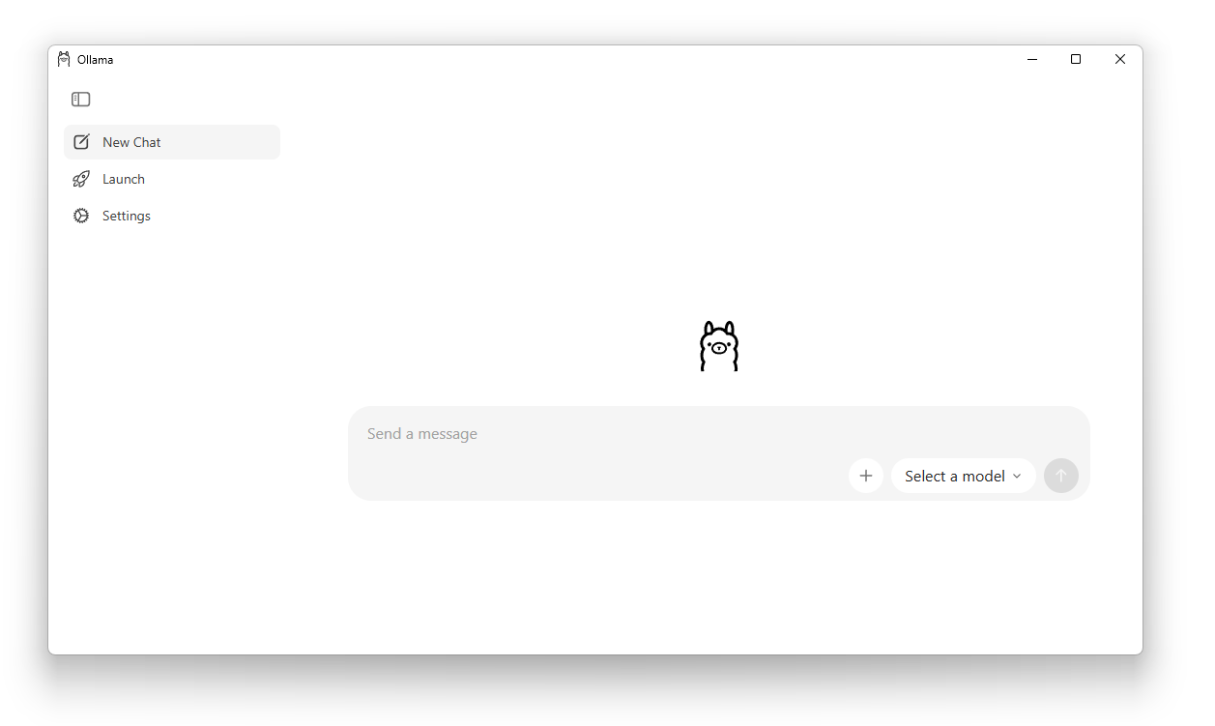
Step # 5
You can simply chat here by pressing new chat button.

Slide 7
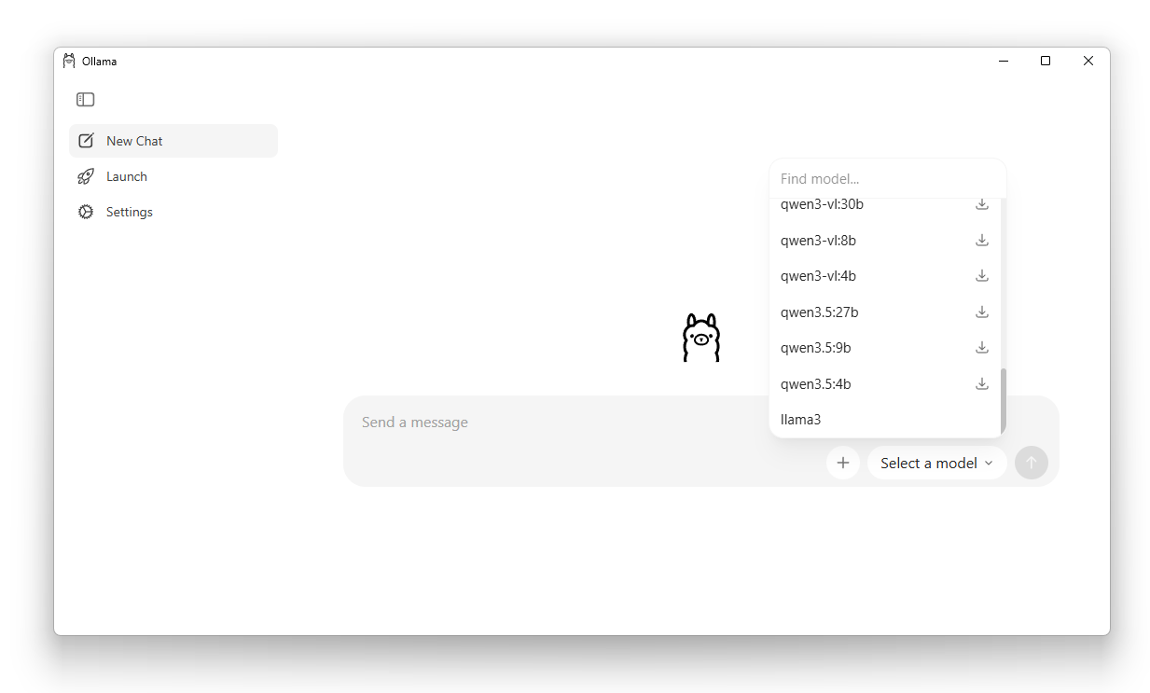
Step # 6
You can simply chat here by pressing new chat button.

Slide 8
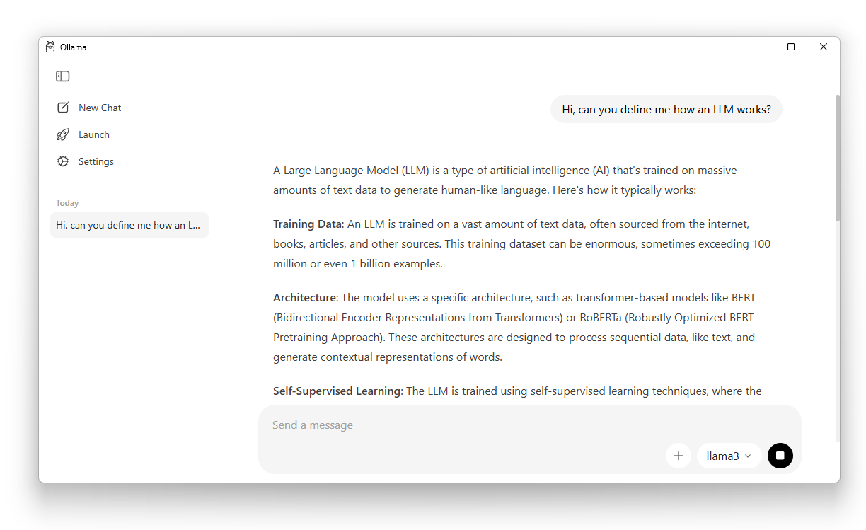
Step # 7
Now chat with it by typing your prompt.

Slide 9
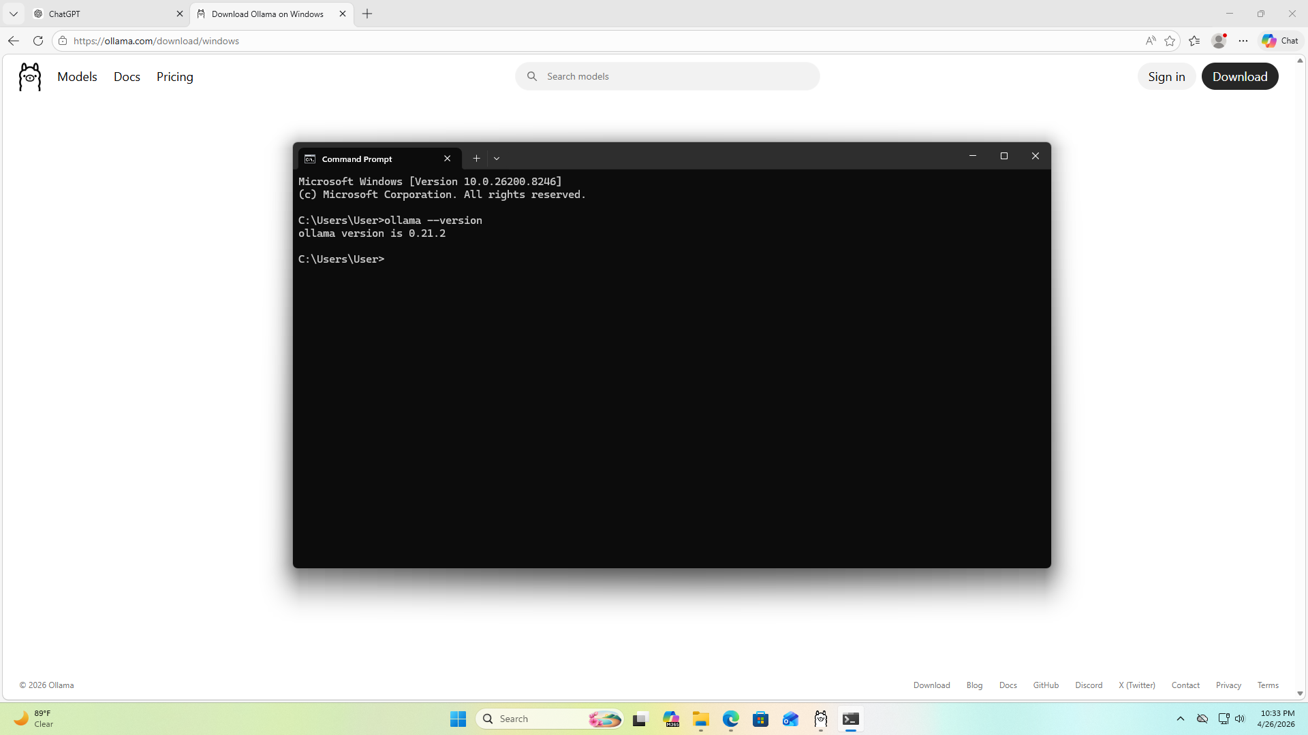
Step # 5
Or we can do it through Command Prompt or PowerShell.
Open Command Prompt or PowerShell and run: ollama --version
If installed correctly, it will show version info.

Slide 10
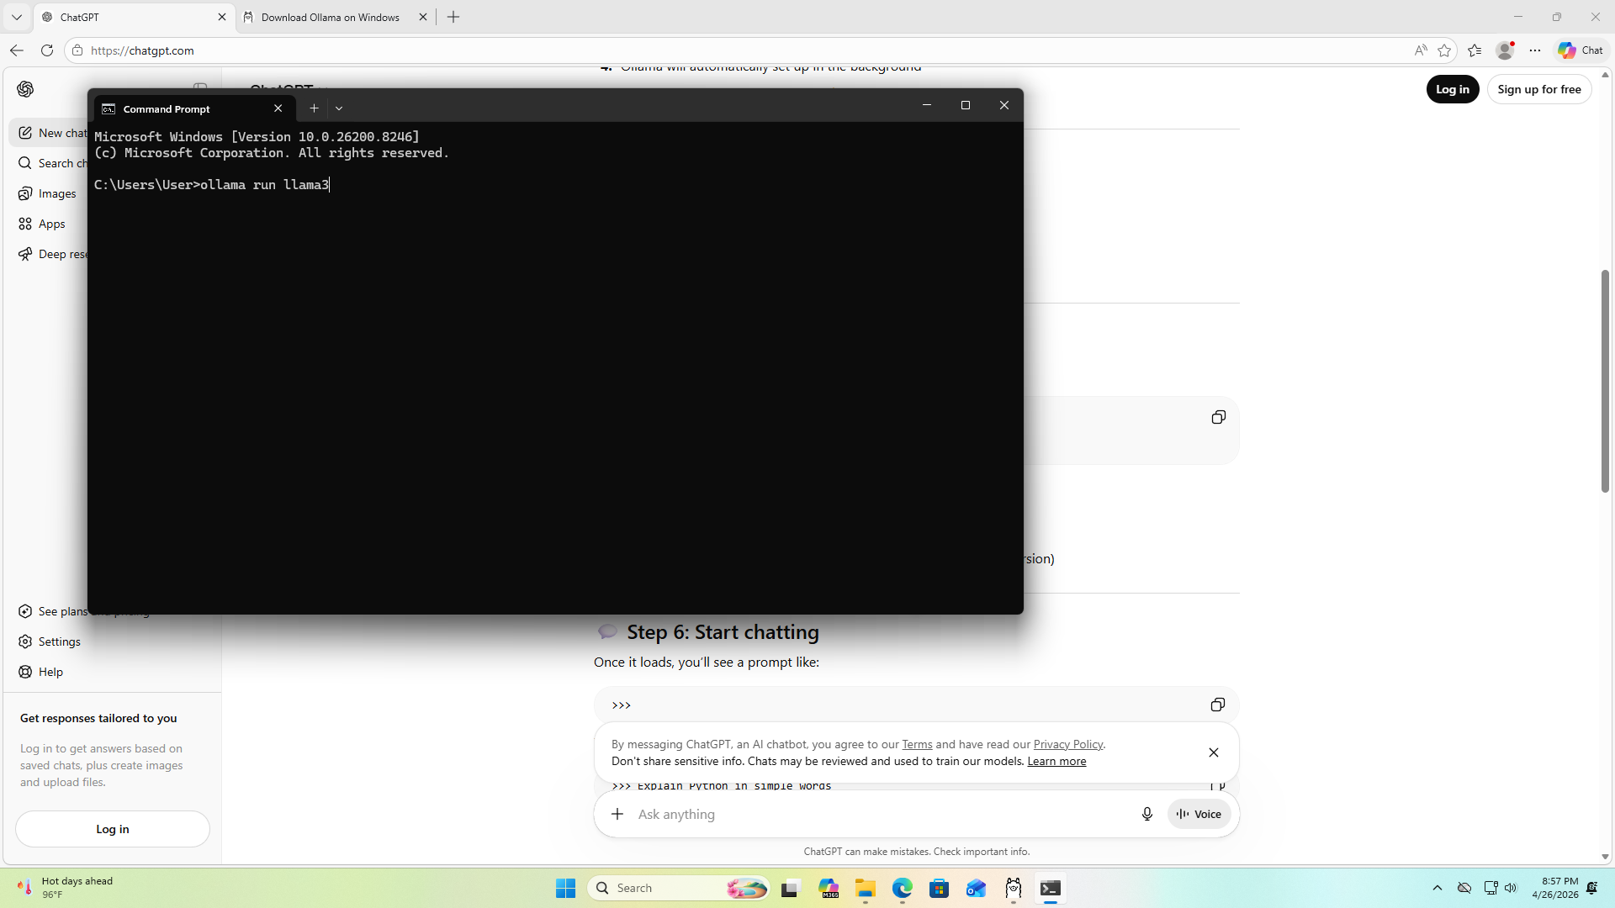
Step # 6
In Command Prompt or PowerShell desired model.
Type: ollama run {model_name}
In this case, we have installed llama3.

Slide 11
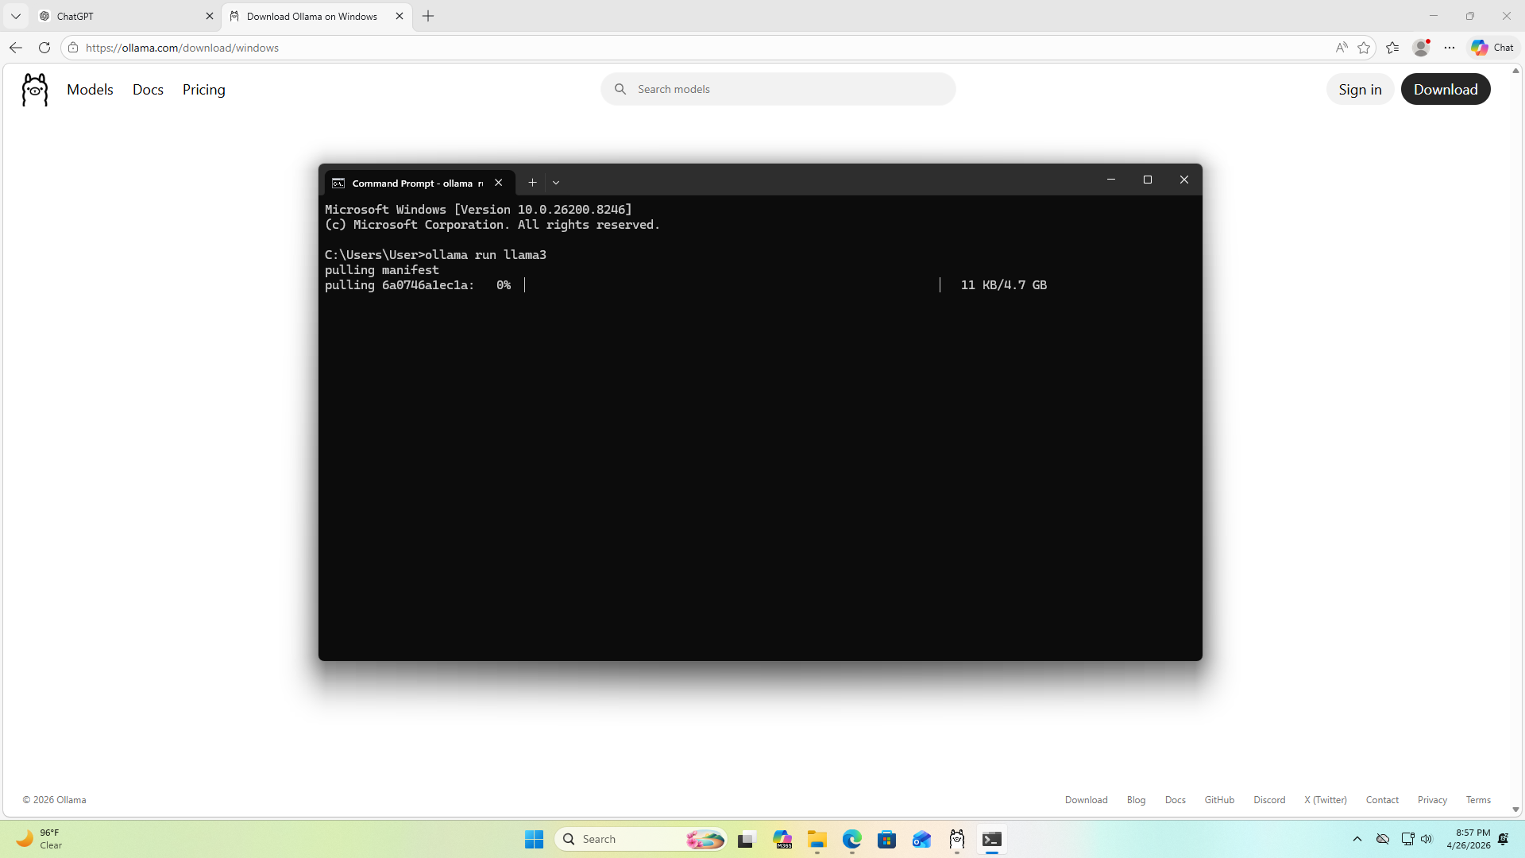
Step # 7
Wait for it to download all the necessary resources.

Slide 12
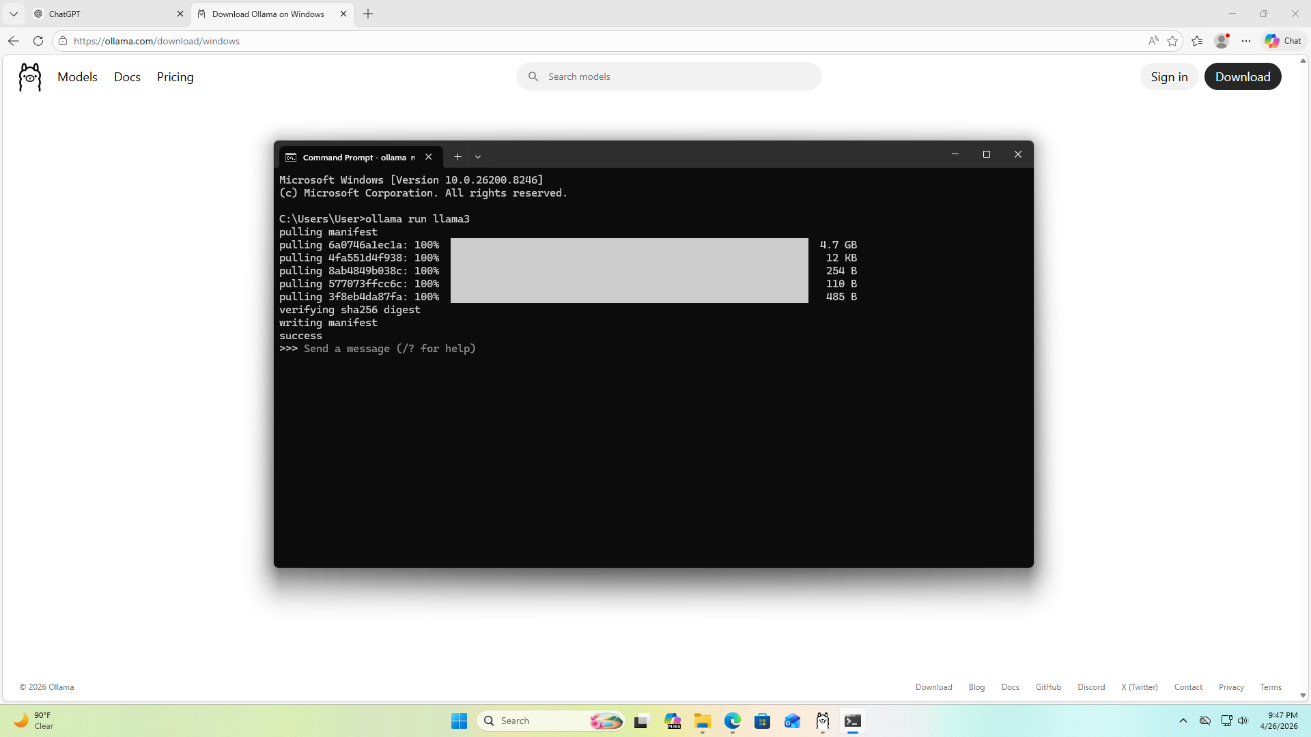
Step # 8
After downloading now you can chat with it freely.

Slide 13
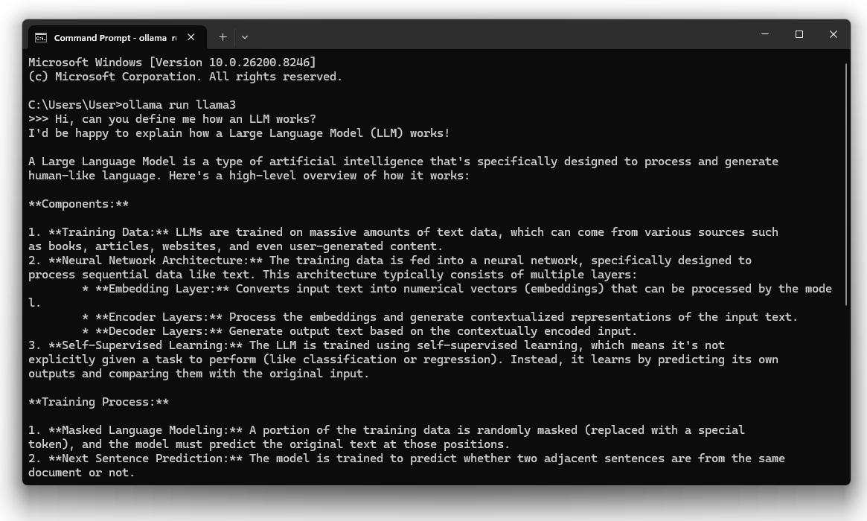
Demo

Slide 14
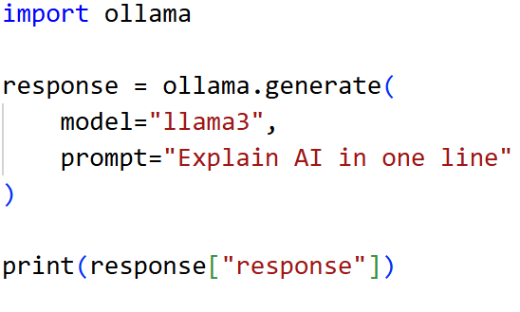
Code
You can easily implement this into your code.

Slide 15
Thank You

